Slide 1
LAB 3 - Bayesian Learning and Boosting

Slide 2
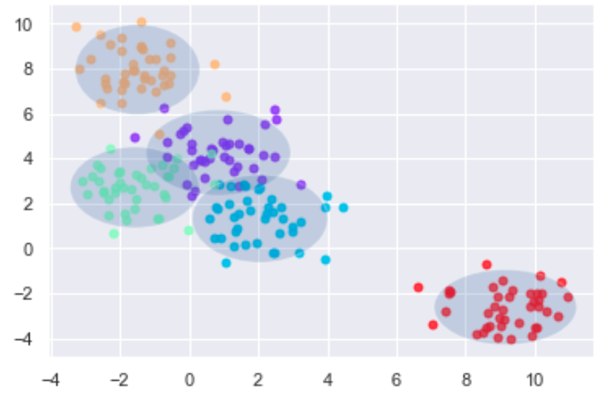
Assignment 2/3.
When can a feature independence assumption be reasonable and when not?
Depends on the application for which you are classifying the data. For example spam filter, housing etc. We have a clear list of data in case of spam filters where it is safe to assume that the features are independent and hence Naïve Bayes classification can be used.

Slide 3
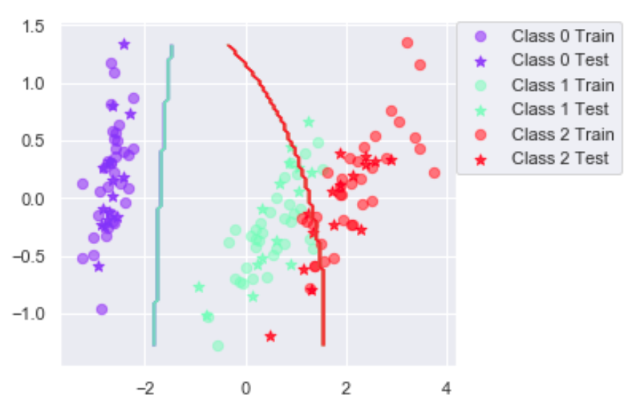
Assignment 3.
(2) How does the decision boundary look for the Iris dataset? How could one improve the classification results for this scenario by changing classier or, alternatively, manipulating the data?
1. The decision boundary seems to be misclassifying some of the data in class 2 & 3 2. We can use the other classifiers such as logistic regression, dec tree or PCA to reduce the dimensionality. And we can use the boosting on NBC for improving the classification.

Slide 4
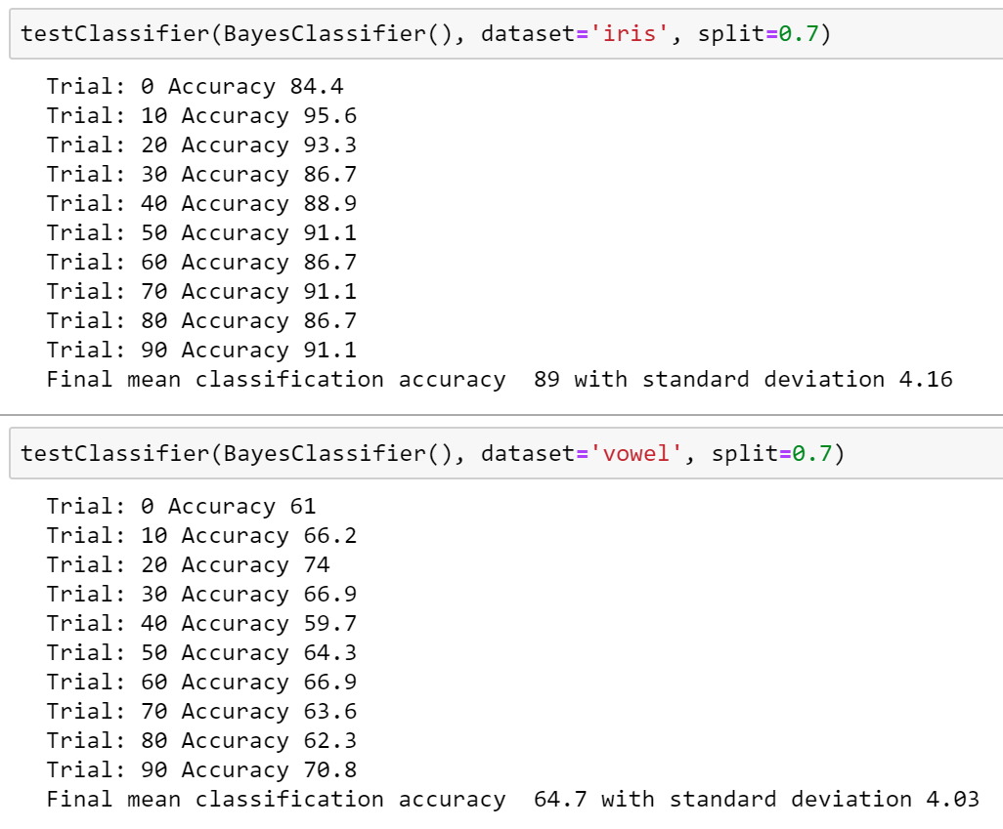
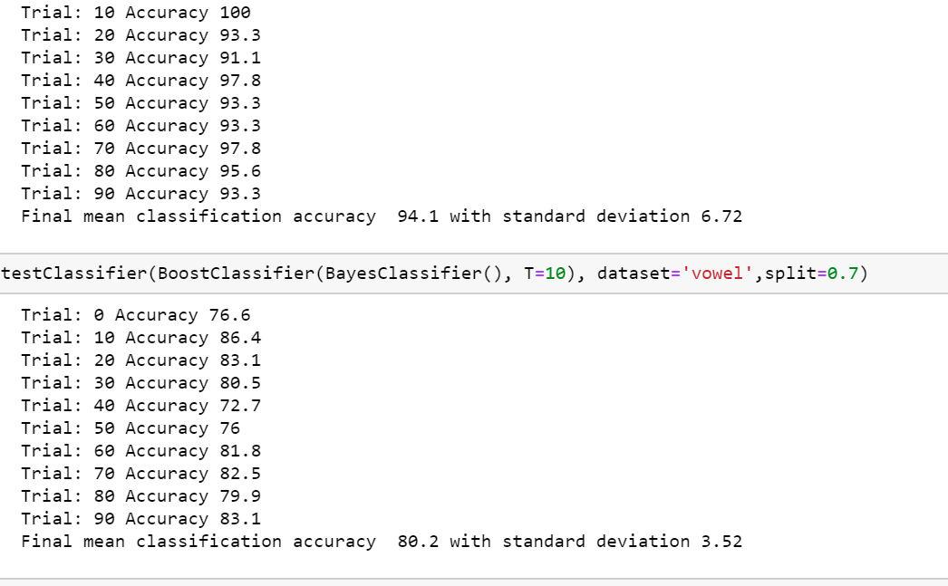
Assignment 5.
(1) Is there any improvement in classification accuracy? Why/why not?

Slide 5
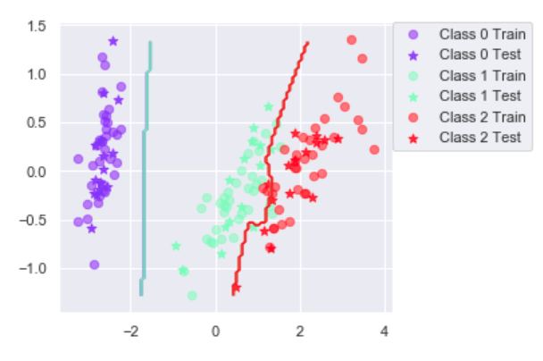
Assignment 5.
(2) Plot the decision boundary of the boosted classier on iris and compare it with that of the basic. What differences do you notice? Is the boundary of the boosted version more complex?
(3) Can we make up for not using a more advanced model in the basic classier (e.g. independent features) by using boosting?
Boosting can result into a overfitting of the data.

Slide 6
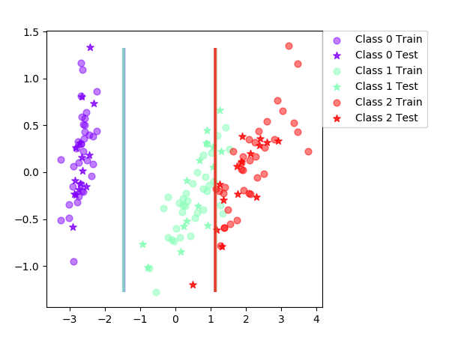

Assignment 6. Answer questions 1-3 in assignment 5 for the decision tree.
Iris Data classification by dec tree
Boosted version of data classification

Slide 7
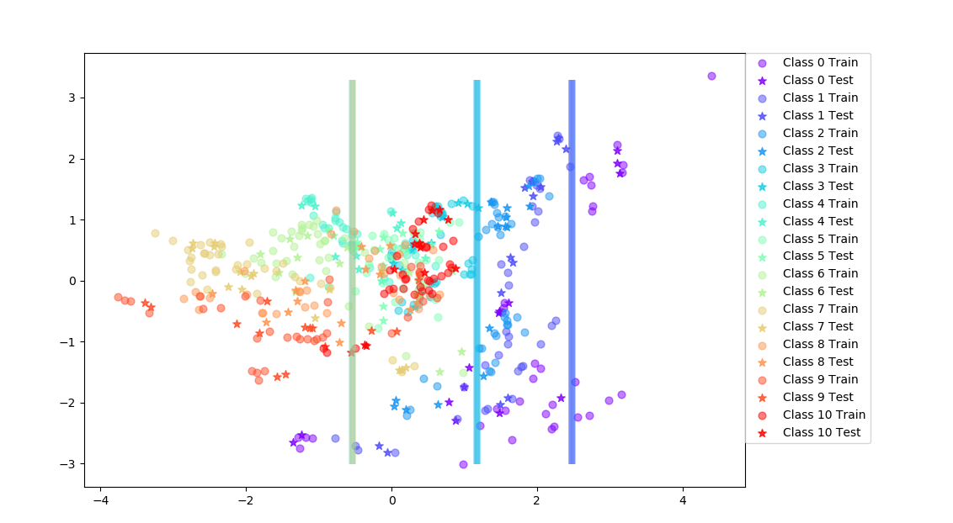
Vowel Data classification by dec tree

Slide 8
Assignment 7.
If you had to pick a classifier, naive Bayes or a decision tree or the boosted versions of these, which one would you pick? Motivate from the following
criteria:
Outliers → Decision Tree with pruning because outliers affect distributions in Naive Bayes so decision boundary will be affected by outliers. If there are few outliers then they will not be relevant to these proportions. For this reason, decision trees are robust to outliers.
Irrelevant inputs: part of the feature space is irrelevant →We can use the pruned decision tree. OR for more complicated way we can reduce the dimensionality by PCA and removing the features we are not contributing towards data and then use NBC.(ignoring the irrelevant features from the data set).
Predictive power → Naïve Bayes classifier has a high predictivity since its using probabilistic computations.
Mixed types of data: binary, categorical or continuous features, etc. → Decision Tree for binary and categorical. And NBC for continuous. In case of Mixed data we would use decision tree.
Scalability: the dimension of the data, D, is large or the number of instances, N, is large, or both. → For larger data set we can use dec tree and for more features in data we can use NBC

